Slide 1
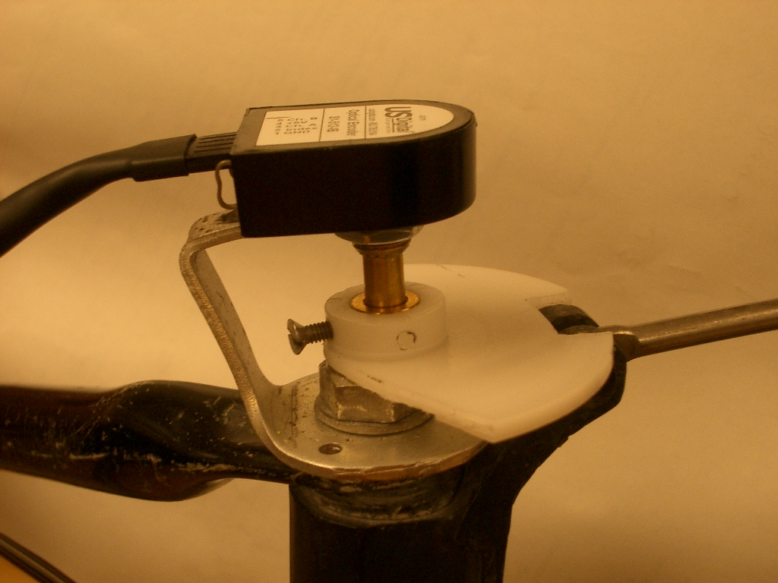
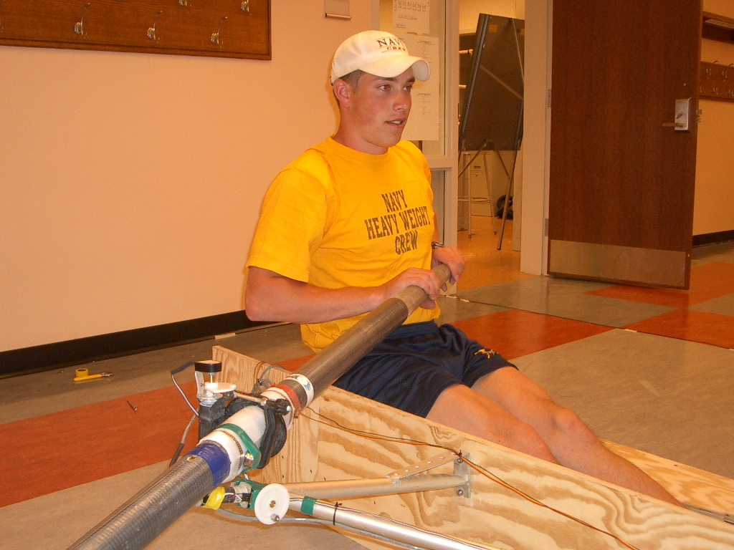
Trial 1 – Successful – Oar Timing Optical Encoder (Horizontal)
Need to know position of oar in the stroke
Decided to use an Optical Encoder
Optical Encoder
ENCL-9

